Slide 1

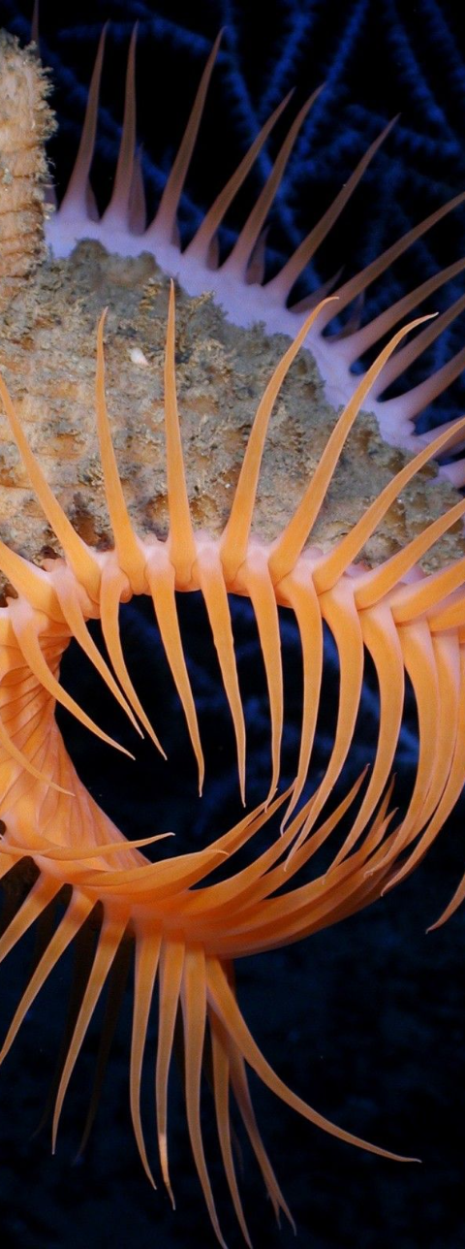

Aquainnovations
Introduction to the Underwater Species Identification Device
Welcome to the future of marine exploration and biodiversity study, where cutting-edge technology meets the enigmatic world beneath the waves. The underwater species identification device stands as a testament to human ingenuity, designed to unlock the secrets of our waters by providing instant identification of the vast and varied marine life that inhabits them. This advanced tool is poised to revolutionize how we interact with, study, and conserve our aquatic ecosystems.
With an ever-growing need for comprehensive environmental data, the underwater species identification device serves as a crucial aid for marine biologists, conservationists, and ocean enthusiasts alike. As we dive deeper into the functionality and application of this device, let us take a moment to marvel at the possibilities it opens up in the quest to understand and protect the blue heart of our plane.
An Project by team Aquainnovations
By:
Paras Chinchalkar from:- First year (Ghrce)
Shlok Mishra Section:-P(CSE-AI)
Aatmanand Tiwari
Divesh Kuthe
-

Slide 2
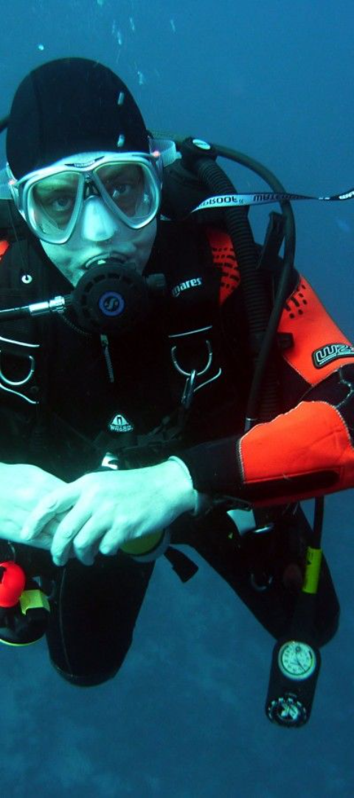



How the Device Works?
The underwater species identification device operates through a sophisticated combination of optics and machine learning algorithms. At its core is a high-resolution camera that captures detailed images of aquatic life, which are then processed by onboard software capable of recognizing and classifying a myriad of marine species.
Upon encountering a creature, the device assesses its shape, color, patterning, and movement to accurately determine its species, even in murky or low-light conditions. This instant access to identification data empowers researchers and enthusiasts to gain insights into marine biodiversity with unprecedented efficiency and accuracy.
Capture
The device captures the image of the marine species using its high-resolution optics.
Analyze
Advanced algorithms analyze the captured data for defining features.
Identify
The species is instantly identified and cataloged in the device's database.

Slide 3
Key Features and Capabilities of the Device
This state-of-the-art device is not only a marvel of technology but also, a beacon of utility for the tasks it is designed to perform. Equipped with a robust suite of features, the device offers a wide array of capabilities crucial for research and observation in the aquatic realm.
Foremost among its capabilities is the real-time data logging and sharing feature, allowing for the collection and dissemination of species information among the scientific community. Enhanced with GPS integration, it can pinpoint the precise location of each species identified, which is a boon for tracking migratory patterns and habitat utilization.
Real-Time Data
GPS Integration
Durable Design
Instant logging and sharing of identification information.
Precise location tracking for ecological studies.
Built to withstand the pressures of deep-water exploration.

Slide 4
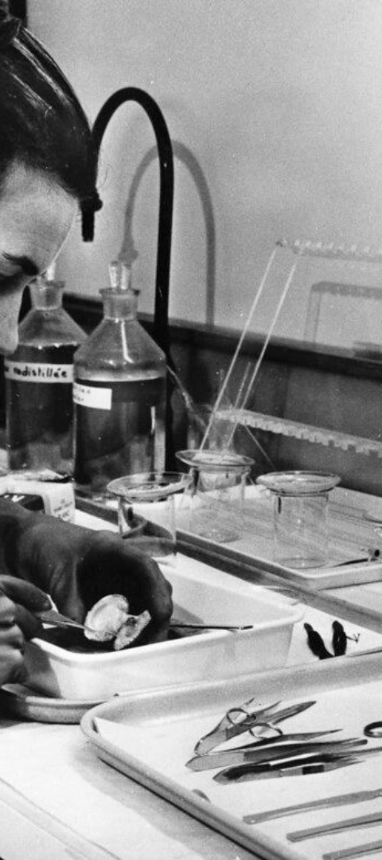
Benefits of Using the Device for Underwater Species Identification
Adopting this device in underwater research endeavors yields a multitude of benefits. It not only enhances the efficiency of species identification but also enriches the overall scope of scientific inquiry and monitoring. It streamlines data collection, cuts down on research time, and reduces human error in species classification.
The device's non-invasive methodology respects the marine environment, avoiding disturbance to the natural behavior of wildlife. Its use in conservation efforts is invaluable, enabling rapid assessment of biodiversity health and aiding in the protection of endangered species.
1
Efficient
2
Accurate
Reduces time and effort in species classification.
Minimizes human error with AI-driven identification.
3
Conservation Aid
Facilitates quick biodiversity health assessments.

Slide 5

Case Study and an research opportunity
Multiple research initiatives and conservation projects have evidenced the profound impact of the underwater species identification device. In coral reef monitoring programs, the device has been instrumental in contributing to the mapping of coral species and their health status across vast areas, furnishing crucial data for reef restoration efforts.
Another success story is the monitoring of elusive deep-sea creatures, where the device's pinpoint identification capabilities have led to the discovery of species previously unknown to science. These case studies exemplify the device's role in enriching our understanding of the underwater world.
1
Coral Reef Monitoring
The device improved data accuracy in coral health assessments.
2
Elusive Species Discovery
Facilitated the discovery of new species in deep-sea explorations.
3
Data Sharing Boost
Enabled efficient data sharing among marine scientists worldwide.

Slide 6
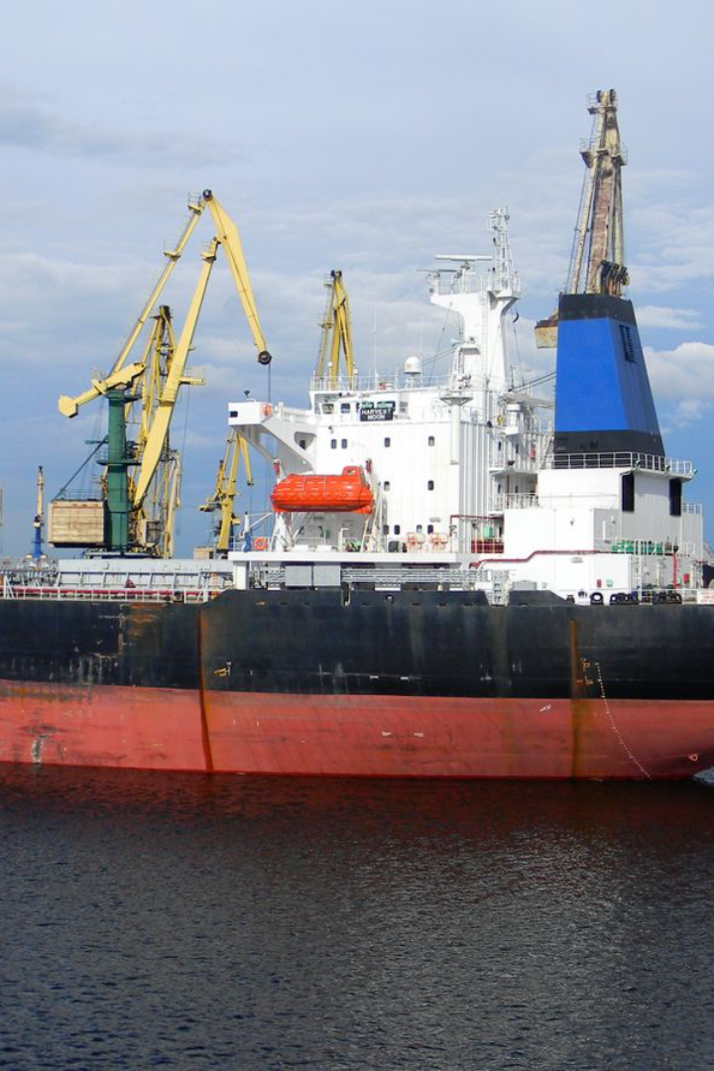
Conclusion and Next Steps
In conclusion, the underwater species identification device represents a giant leap forward for marine science. Its contributions to species identification, data collection, and conservation are unparalleled, and its potential is just beginning to be tapped. As we look ahead, further advancements and wider adoption of the device can be anticipated, leading to even greater insights into our oceans and the life within them.
The next steps involve scaling the technology, refining the identification algorithms, and expanding the database to include even more obscure and lesser-known species. We stand on the brink of a new era of underwater discovery, and with this device, we are well-equipped to venture forth into the depths.
Innovation
Continuing to push the boundaries of marine technology.
Collaboration
Building partnerships for wider technology adoption.
Conservation Focus
Utilizing the device to support global conservation initiatives.

